Slide 1
Basic Biological Concepts
Lecture 2 – Types of Living Organisms: Taxonomy
BIO 10 – Spring 2020

Slide 2
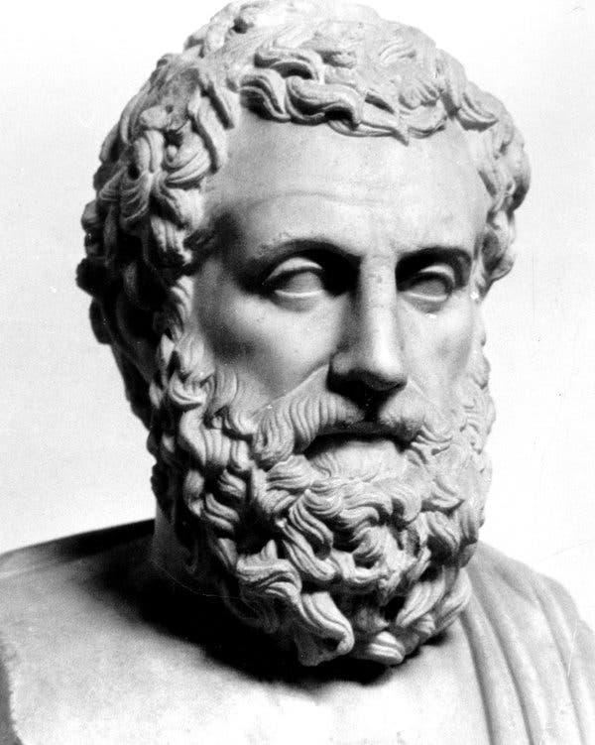
Classification of Life
Since the first naturalists (Aristotle’s, 3-400 BC), people have been putting organisms into groups for classification
The science of classifying organisms is called taxonomy

Slide 3






Initially, all classifications were done based on the morphology (structure) of organisms.
The more similar the outward appearance of two organisms, the more closely related they were thought to be.
Cats were more closely grouped with dogs than with birds since cats look more similar to dogs than birds
Similarly, cats and dogs were more closely grouped with birds than with oak trees based on morphology
Mammalia
Animalia
Avia
Plantae

Slide 4
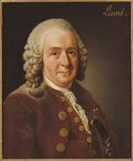
In the 1700’s Carl Linnaeus and others had constructed a system of categorizing all life into different groups (called taxa)
All naming was done in Latin since it is a dead language and therefore isn’t changing over time like other languages

Slide 5
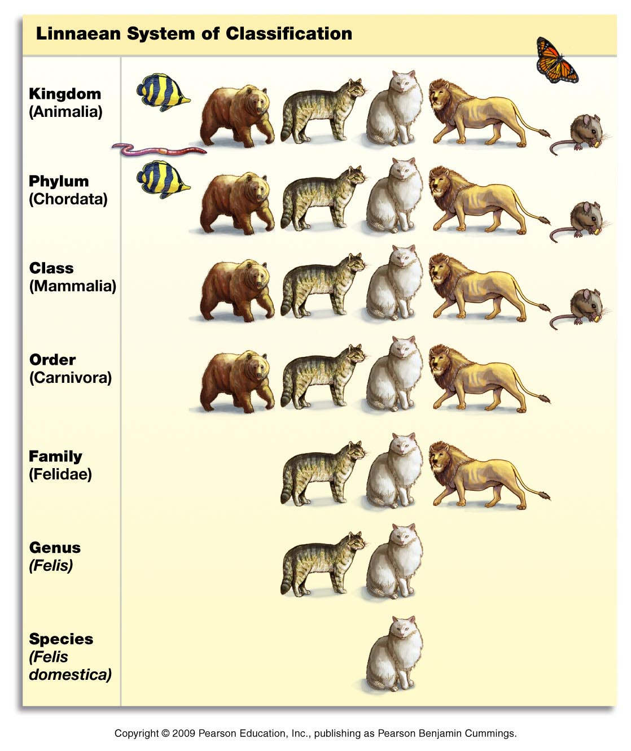
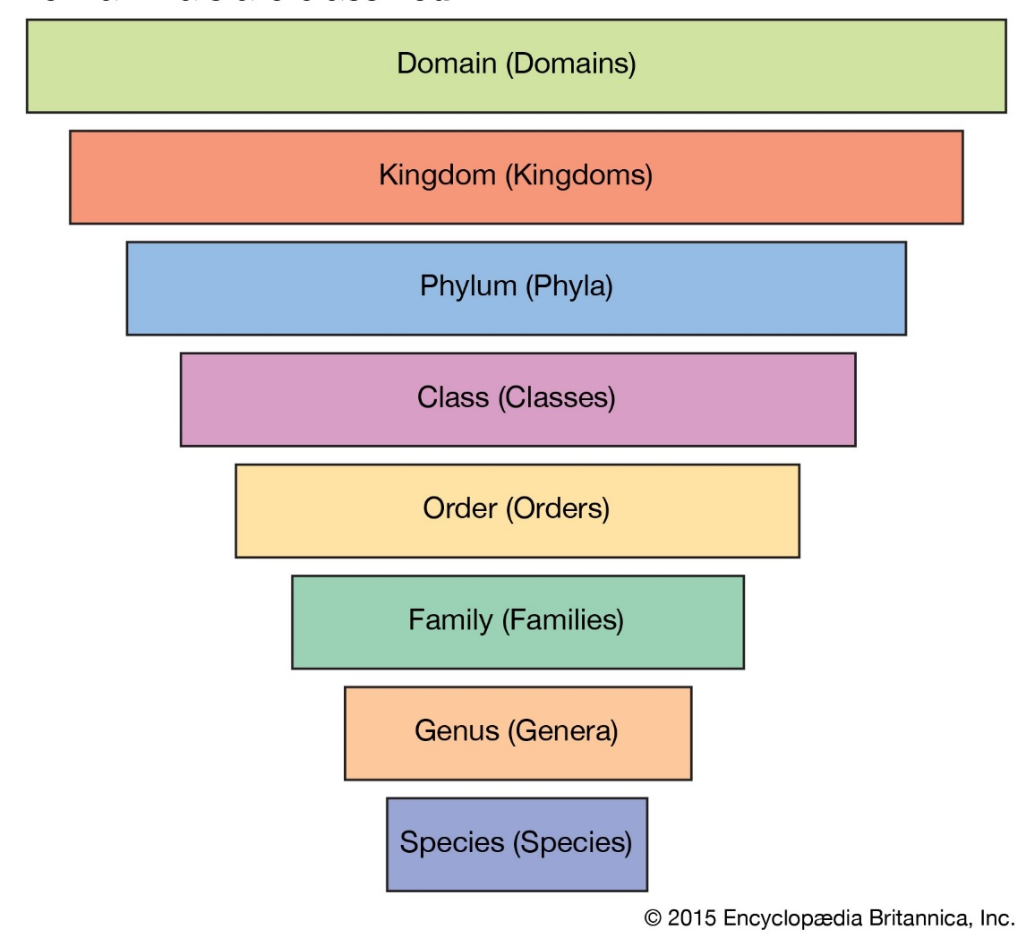
Linnaean Taxonomic Classifications

Slide 6
Originally, the largest (most inclusive) groupings of organisms were called Kingdoms
At the beginning, there were only two kingdoms: Plantae and Animalia (plants and animals)
As more knowledge is accumulated about organisms, the classifications are constantly being updated and rearranged
Eventually, more kingdoms were added and a whole new grouping was added above kingdoms, called domains
Species are defined as organisms which can interbreed and produce viable offspring

Slide 7
The biggest change in taxonomy occurred when biologist began to group organisms not by their outward structure, but by their “relatedness” (common ancestry)
The study of evolutionary relatedness between species is called phylogenetics

Slide 8
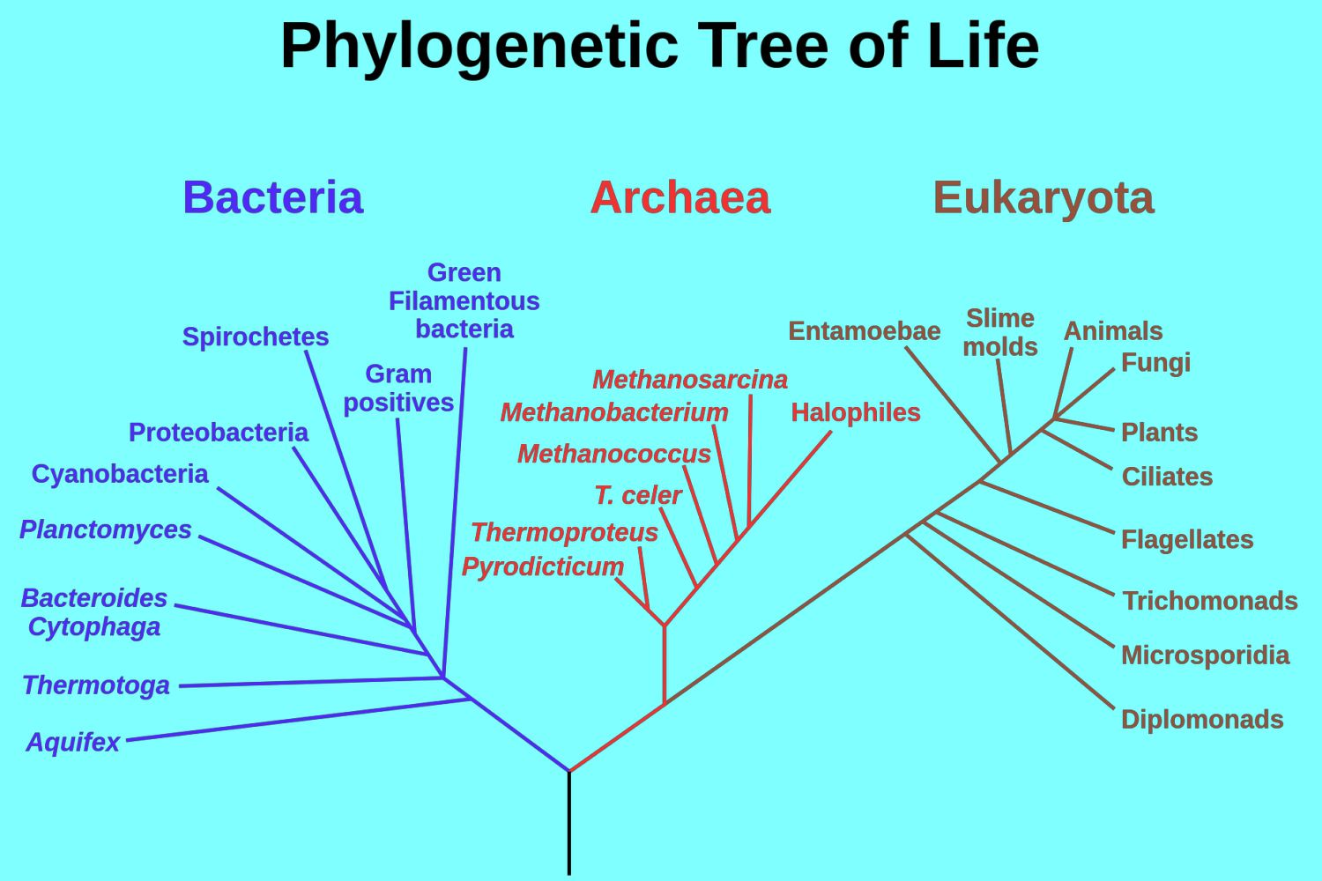
The Three Domains of Life

Slide 9
Basis for Bacterial and Archaeal Classification
Small single-celled prokaryotic organisms
No nucleus and are far less complex than eukaryotic cells
Reproduce quickly by binary fission (every 20 min in ideal conditions)
No sexual reproduction, so ‘species’ has different meaning
Built to share genes and evolve very rapidly
Genetics and biochemistry define different species

Slide 10
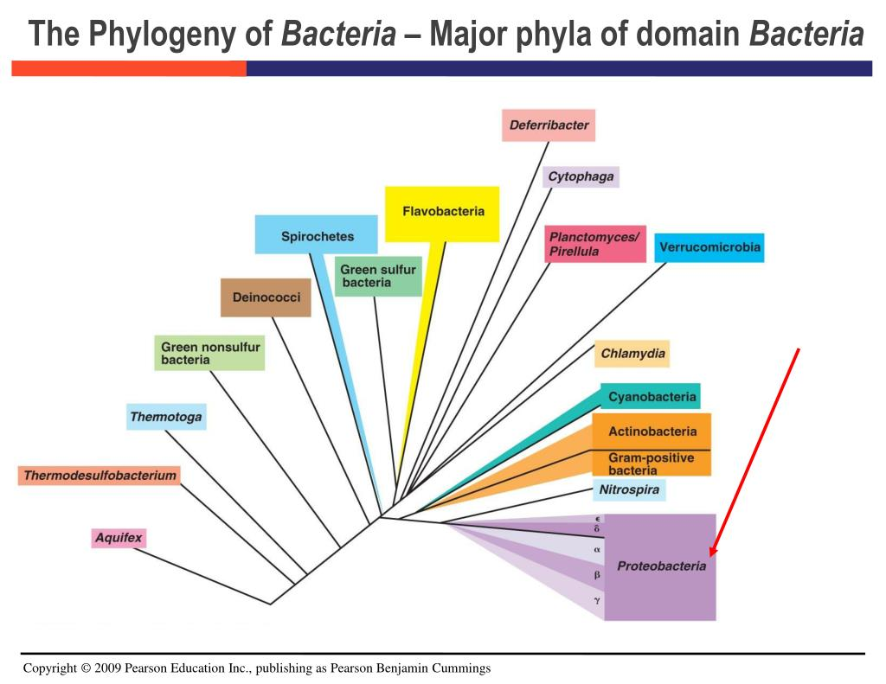
The number of major phyla has increased from 12 identifiable lineages in 1987, to 30 in 2014, to currently over 50 including candidate phyla.
The total number has been estimated to exceed 1,000 bacterial phyla.

Slide 11
Bacteria are very successful organisms
There are 10 times more bacterial cells living on or in you than you have human cells (enough to fill a half-gallon jug)
There are more bacteria in your mouth than there are humans on the planet

Slide 12
Additional Basis for Archaea Classification
Classification is rapidly moving and contentious, most have not been studied and classified.
Many are unusual: use alternatives to carbon for energy, live in extreme conditions (extreme cold, heat, pH, pressure, saltiness, etc)
Classification systems rely on sequence of ribosomal RNA genes (molecular phylogenetics).
Thought to be closer to eukaryotes than eubacteria

Slide 13
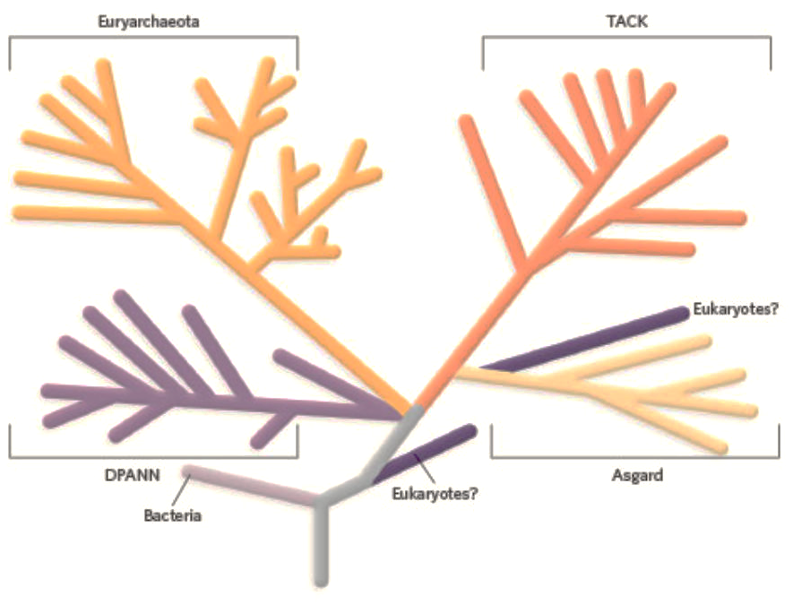
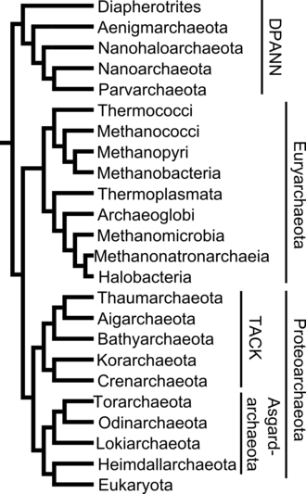
The TACK superphylum has been proposed that may be related to the origin of eukaryotes.
More recently, the Asgard superphylum has been proposed to be more closely related to the original eukaryote.

Slide 14
Basis for the Eukarya Classification
Eukaryotes are organisms whose cells have a nucleus enclosed within membranes.
Also contain other membrane-bound organelles such as mitochondria and the Golgi apparatus, and in addition, some cells of plants and algae contain chloroplasts.
Unlike unicellular archaea and bacteria, eukaryotes may also be multicellular and include organisms consisting of many cell types specialized into different kinds of tissue.
Some eukaryotes can reproduce both asexually through mitosis and sexually through meiosis and gamete fusion.

Slide 15
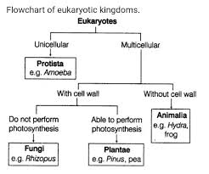
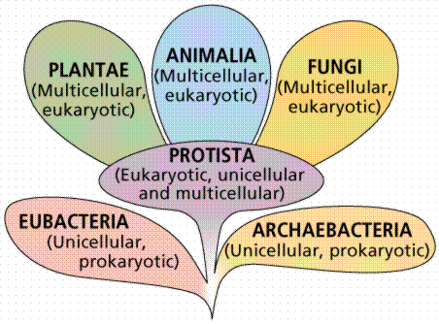
Traditional Eukaryotic Kingdoms
The protists were the first eukaryotes. They gave rise to plants. Next came fungi, and finally animals appeared on the planet

Slide 16
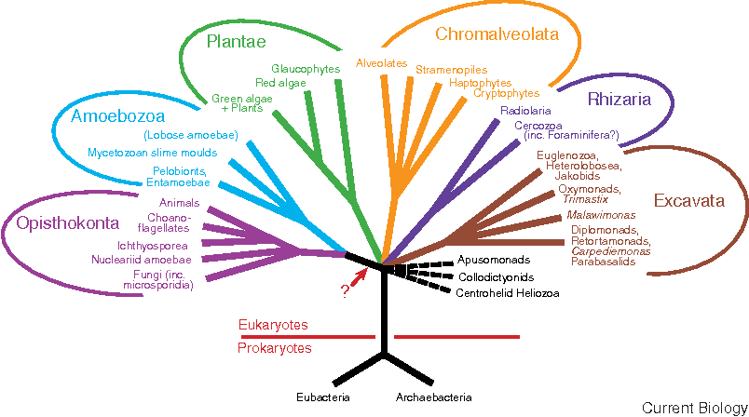
A New Schema for the Kingdoms of Eukarya Based on Molecular Genetics and Work with Ancient Species

Slide 17
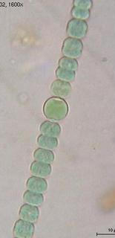
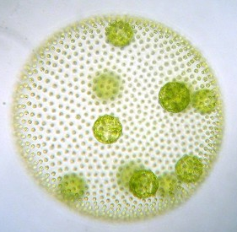
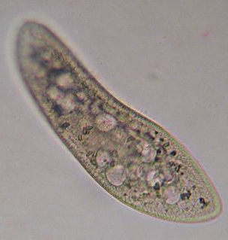
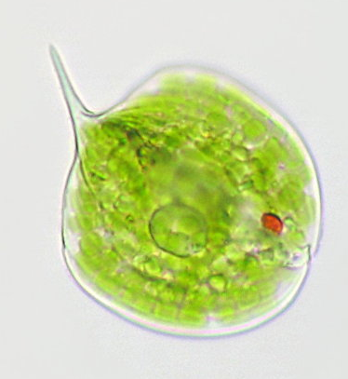
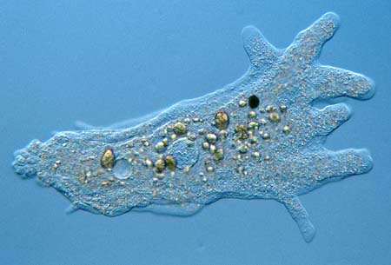
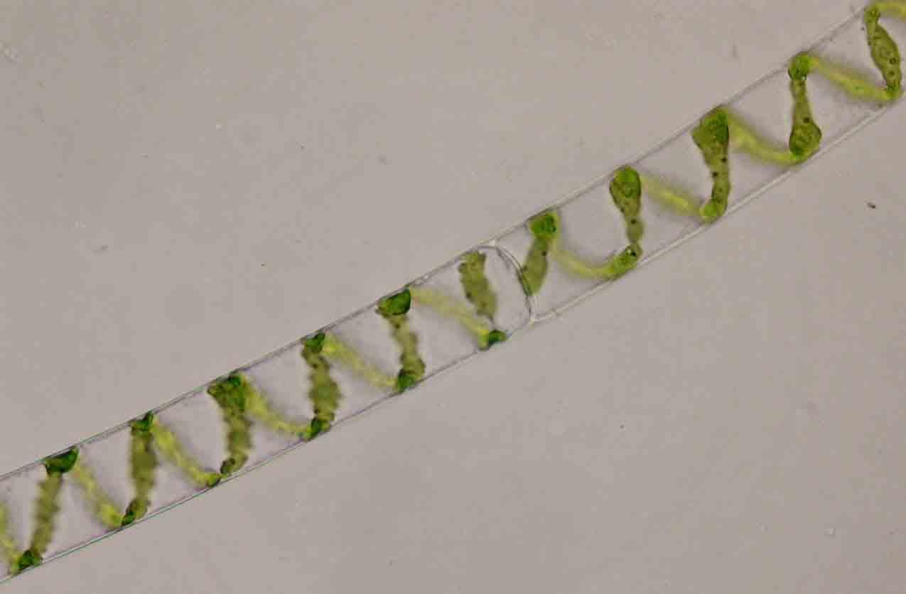
Kingdom Protista
anabaena
volvox
paramecium
Neither plant nor animal nor fungi
Usually single-celled but can be multicellular
Always aquatic
Include: amoeba, paramecium, algae, and thousands more
euglena
amoeba
spirogyra

Slide 18
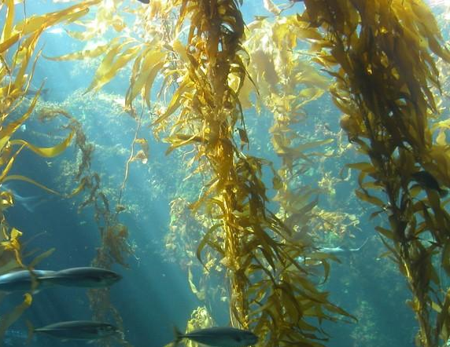
Protists
While most protists are single-celled and microscopic, brown algae (kelp) grows in giant underwater forests

Slide 19
Protists
Many diseases are caused by parasitic protists:
Amoebic dysentery – found in contaminated water
Malaria – Kills ~2.7 million people/year
Giardia – Found in contaminated water (lakes, rivers, streams)
African sleeping sickness – Attacks the central nervous system

Slide 20
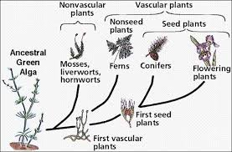
Kingdom Plantae
There are 2 Subkingdoms:
Nonvascular plants
Vascular plants
There are 4 Divisions:
Mosses
Ferns
Gymnosperms (conifers)
Angiosperms (flowering)
All plants are thought to have evolved from green algae

Slide 21
Fungi
Fungi include: yeast, mold, penicillium, mushrooms, truffles, and others
Genetically, fungi are more similar to animals than plants
Perform the essential role of decomposing organic matter
While many cause infections and disease, many are helpful to humans
Fungi are eaten (mushrooms and truffles) and used to make beer, wine, bread, and cheese
Many fungi are used for their anti-bacterial properties

Slide 22
Animalia
Animals have more identified species (by far) than all other organisms combined – mostly due to the huge numbers of insects identified.
Animals were the most recent kingdom of organisms to appear on the planet
Animals are more complex in structure than other organisms
Animalia has 9 Phyla – vertebrates, like us, fall under the Phylum Chordata

Slide 23
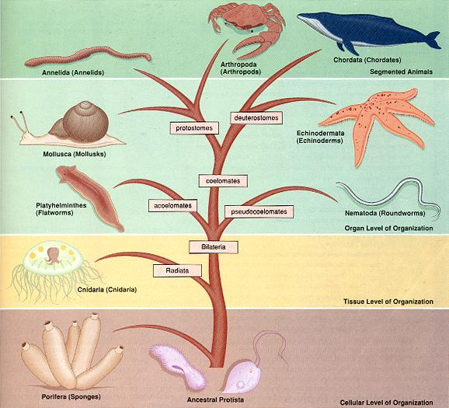
First Aristotle and then Darwin Developed the Taxa for Animalia
Both were embryologists and used the early embryo, rather than adults, to place animals in their taxa.
Their work has matched the new DNA technologies very closely.

Slide 24
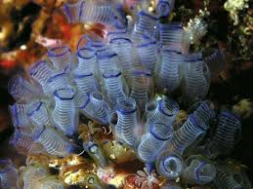
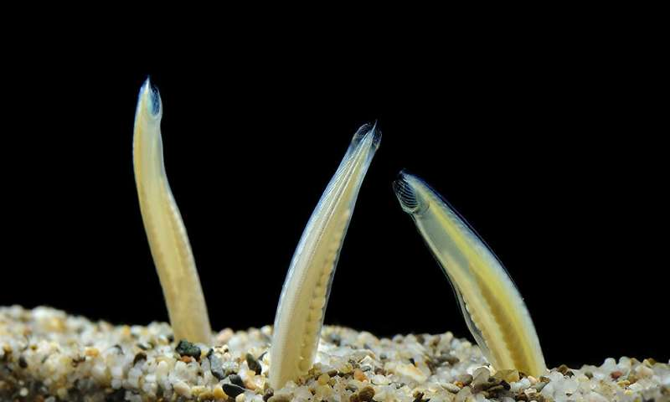
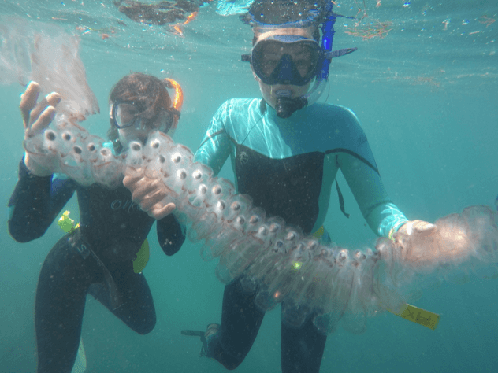
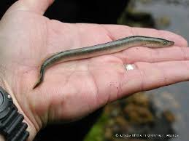
Chordates are divided into three subphyla:
Vertebrata Tunicata or Urochordata Cephalochordata
Fish Sea squirts Lancelets
Amphibians Salps
Reptiles
Birds
Mammals

Slide 25
There are three main classes of arthropods:
Crustaceans Unirama Cheliceramorpha
Shrimp Insects Arachnids
Crabs Centipedes Spiders
Lobsters Millipedes Scorpions
Crayfish Ticks
Krill Mites
Barnacles Horseshoe crabs
Copepods
Water fleas

